Slide 1

For Loop Statements
Loop statements allow you to execute a statement, or a group of statements, multiple times
Types of loops in C programming:
for loop
while loop
do...while loop
Jump statements alter the normal execution sequence of a program:
continue - skip some statements inside the loop
break - terminate the execution of the remaining loop statements
goto - jump from one statement to another within a function

Slide 2
Syntax
Syntax: for (int i = 1;i <= 5;i++) {
printf(“i = %d\n”, i);
}
Output: i = 1
i = 2
i = 3
i = 4
i = 5

Slide 3
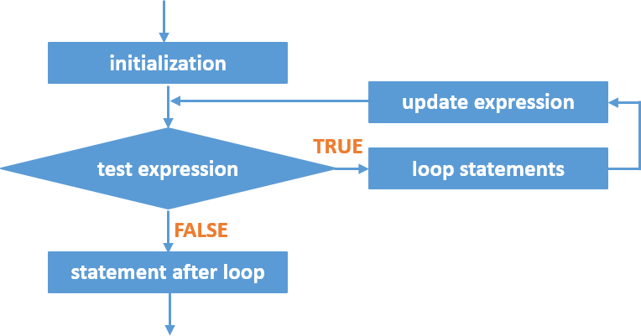
Flowchart

Slide 4
Order of operations
The initialization is executed first and only once to initialize the loop control variable/counter
The test expression is evaluated
If test expression is found to be false (0), the loop statements will not be executed. Program control jumps to the next statement after the “for” loop.
If test expression is found to be true, the statements within the loop will be executed
The update expression is executed. It will update the loop control variable/counter.
Step 2 is repeated until the test expression becomes false or loop is terminated using break statement.

Slide 5
Rules
for is a keyword and must be used only in lower case letters
for statement can be an empty statement
Every for statement must include initialization, test expression and update expression. They can be empty but must be separated with semicolon (;)
Example:
for(i=1; i<10; i++)
{
}
Result: Variable i is incremented

